Slide 1

Chapter 16– Connecting LANs

Slide 2
Limitations of Ethernet Technologies
Distance (the length of the cable)
  200 m in Thin Ethernet (10Base2)
  100 m in twisted pair Ethernet (10BaseT or 100BaseT or Fast Ethernet)
Number of collisions when too many stations are connected to the same segment
The situation is similar in other LAN technologies

Slide 3
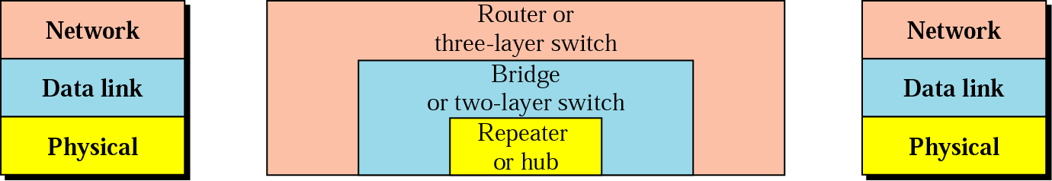
Devices that Extend Local Networks
Physical layer devices (Repeaters and hubs)
MAC layer devices (Bridges and two-layer switches)
Network layer devices (Routers and three layers switches)

Slide 4
Repeaters
  Used for linking LANs segments due to the constraints imposed by the length of cables
    Repeater work at the physical layer and they recognize only electrical signals representing bits)
  Used also on long distance point-to-point links
  The intention is to have a single network
    The distance is extended, but the collision domain is the same
  Basically dummy devices, with no software, just repeating (regenerating) the signals from one segment to another
  Low cost and ease of configuration
    Plug-and-play

Slide 5
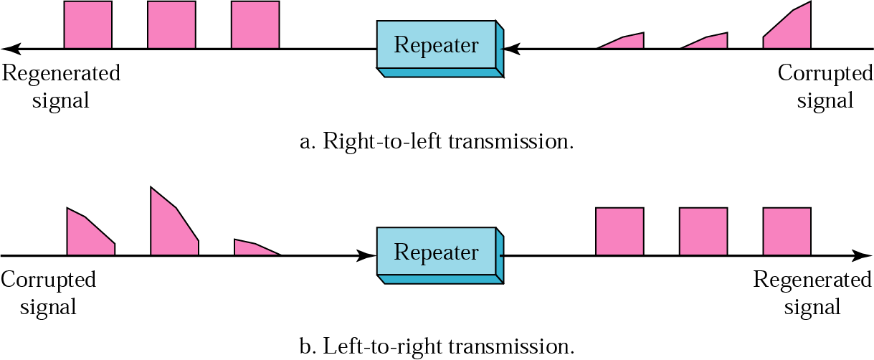
Repeater is a Regenerator

Slide 6
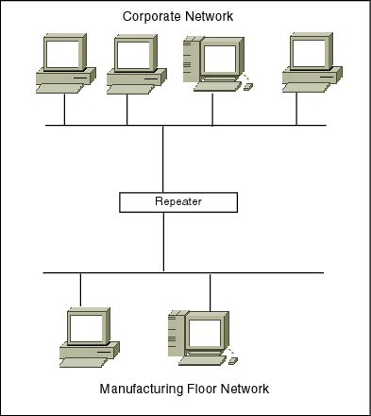
Extending LANs with Repeaters
Repeater
Repeater
Repeater
Merging Corporate and Manufacturing floor networks into one LAN
Extending Thin Ethernet in a building with three floors

Slide 7
Repeaters: Advantages and Disadvantages
Advantages
  Plug and play (no configuration required.)
Disadvantages
  Not scalable (Ethernet standard allows only 4 repeaters. More than 4 would introduce unacceptable delay.)
  No hetoregenity (The connected networks must have the same electrical properties.)

Slide 8
Hubs
A multiport repeater used in 10BaseT and Fast Ethernet
Hubs give a possibility to have a star topology
The advantage to a repeater is in the easy way of adding and removing additional hosts
Connecting several hubs helps the length of the network can be extended

Slide 9
Hub’s Limitations
Resolves the problem with the distance, but does not resolve the problem with collisions.
The net with the hubs can have lower throughput than the separate networks.
The througput of the three separate networks = 3x10Mbps
The throughput of the connected network = 10Mbps

Slide 10
Protocol Stacks with Repeaters or Hubs
Telnet, FTP,
HTTP, email
application
application
transport
transport
network
network
data link
data link
10Base-T
physical
physical
Host on
network 1
Repeater or hub
(forwards bits)
Host on
network 2

Slide 11
Bridges
Improve performance, not only by extending the distance, but also by traffic partitioning.
Forward frames based on destination’s MAC address – operate at tha data-link layer.
  Bridges can understand Ethernet frames.
Separate stations connected to different ports of the bridge.
Foprward frames on the other ports only when necessary, thus separating traffic.

Slide 12
Bridges – A Simple Example
The frame from H1 to H4 is forwarded by the bridge
The frame from H1 to H3 is dropped by the bridge
H1
H2
H3
LAN1
H4
H5
H6
B1
P2
P1
LAN2
Traffic within the same group
Traffic between the two groups

Slide 13
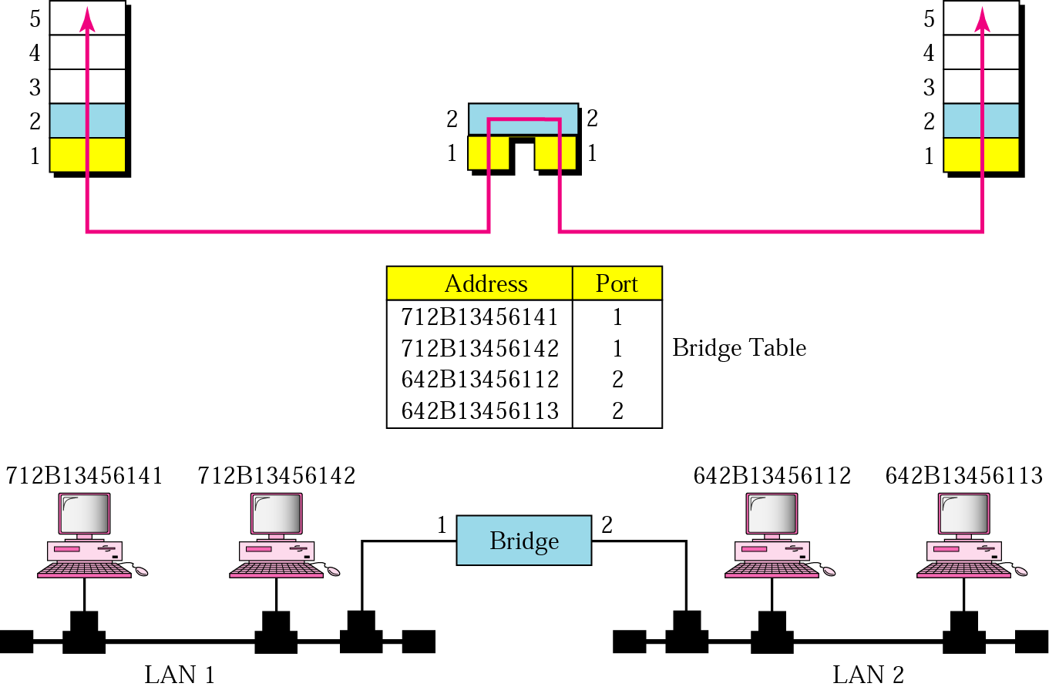
Bridge table

Slide 14
How Does a Bridge Know
Where the Nodes are Located?
Different techniques exist
Static
  administrator types them in and maintains them
  too much trouble
  lack of flexibility
Dynamic
  Bridges learn themselves
  administrators don’t have to maintain them!
  transparent operation. Plug and Play!

Slide 15
Learning Bridges
Learning Algorithm
  Start with empty hash table T that maps hosts to ports
  Receive frame from host x(src. addr, des. addr.) on port Pi, i=1,2,..
  Add (src. addr., Pi)
  Delete old entries
Forwarding Algorithm
  Receive frame f from host x(src. addr, des. addr.) on port Pi
  If T(des. addr.) = pi, discard the frame
  If T(des addr.) = pj (j ≠ i), forward on port pj
  Else, T(des. addr.) is empty, forward on all the ports

Slide 16
Learning Algorithm - Example
B1
B2
P1
P2
P1
P2
t₁
A
A
C
F
A to F
t₂
C
C
C to H
P1
B2
P2
t₃
D
D to E
D
t₄
B
B
B to C
t₅
B
E
H
H
H to D
H
P1 and P2 are port1 and port2 for bridges B1 and B2
t₆
F
F
F to A
P1
P2
B1
t₇
E
E to A
E
t₈
D to E
A means station A with Ethernet address A
t₉
A to D
A
D
t₁₀
B to E

Slide 17
Cycles in Bridged Network
1. host writes frame F
to destination which is
unknown for B1 and B2
2. B1 and B2
forward the
frame, F1 and F2
are generated
3. B2 receives F1,
B1 receives F2
F
B1
B2
B1
B2
B1
B2
F1
F2
F2
F1
4. B1 and B2
forward the
frames F1 and F2
5. The situation in 3. is repeated and the frames are sent back
6. The frames can circulate in the network for ever
F2
F1
F1
F2
B1
B2
B1
B2
B1
B2
F1
F2

Slide 18
Spaning Tree Bridges
Used to introduce redundancy in a network in order to make it more reliable.
  If one bridge fails, the other can overtake.
  If all ports are kept active, loops can appear (circulation of broadcast frames is possible), duplicated frames are possible.
By using the spanning tree, some ports are disabled and there is exactly one path from every LAN to every other LAN (no cycles and no circulating frames).
  The redundancy cannot be used to split the traffic.

Slide 19
Spanning Tree - Example
The corresponding graph
1
The network
B1
B1
Network 1
Network 2
1
2
3
4
Network 4
Network 3
B2
B2
Networks are graph nodes, ports are graph edges
The spanning tree is a connected graph which has no loops (cycles)
The dotted links are the block ports on the bridge, in order to prevent loops and duplicated frames

Slide 20
Spanning Tree Algorithm - Definitions
Each bridge is assigned a unique identifier: Bridge ID
  If not assigned, the lowest MAC addresses of all ports is used as the bridge ID
Each port within a bridge has a unique identifier (port ID). Typically the MAC address of the port is used.
Root Bridge: The bridge with the lowest identifier is the root of the spanning tree.
Root Port: Each bridge has a root port which identifies the next hop from a bridge to the root bridge. This is the port through which the root can be reached with minimum cost.

Slide 21
Spanning Tree Algorithm – Definitions (cont.)
Root Path Cost: For each bridge, the cost of the min-cost path to the root.
Costs are assigned to each port or hop count is used
Designated Bridge, Designated Port: Single bridge on a LAN that provides the minimal cost path to the root for this LAN:
  If two bridges have the same cost, select the one with highest priority
  If the min-cost bridge has two or more ports on the LAN, select the port with the lowest identifier

Slide 22
Multiple LANs with Bridges with Costs Assigned
L1
4
4
LAN 1
6
B1
B5
B6
Cost=4
2
1
B1
5
Cost=6
LAN 2
Cost=2
L2
L3
B6
Cost=4
2
3
Cost=5
Cost=6
Cost=2
B5
B3
6
B3
6
B2
Cost=3
LAN 3
Cost=1
B2
B4
Cost=4
4
5
L4
Cost=6
B4
The cost of sending from L1 to L4 via B1 and B2 is 6
Only costs for going from a bridge to a LAN are added
Cost=5
LAN 4

Slide 23
Spanning Tree Algorithm
Elect the root bridge
Find the root port for every bridge
Determine the designated bridge for each LAN and the designated port on the bridge
Mark the root port and designated ports as forwarding (active) ports, the others as blocking (non-active) ports

Slide 24
Example: Root Bridge and Root Ports
L1
4
Root bridge and root ports are marked in red
No root port to L4
Root
4
6
B1
B5
B6
2
1
Cost=3
Cost=6
5
L2
2
3
L3
6
B3
6
Cost=2
B2
B4
Cost=8
4
5
Cost=6
L4

Slide 25
Example: Designated Ports and the Spanning Tree
L1
L1
4
4
Root
L1
L2
4
6
B1
B5
B1
B5
B6
B6
2
2
1
Cost=3
Cost=6
5
3
L2
2
L3
L2
2
3
L3
6
B3
6
B3
6
Cost=2
L3
B2
B4
B4
Cost=8
4
B2
4
5
Cost=6
L4
L4
L4

Slide 26
Another example
B8
B3
B5
B7
B2
Cost for each
port is 1
(hop-count)
B1
B6
B4

Slide 27
The Root Bridge and the Spanning Tree
B8
B3
Spanning Tree:
B5
B1
B7
B2
B2
B4
B5
B7
B1
Root
B8
B6
B4

Slide 28
Bridges: Advantages and Disadvantages
Advantages:
  Plug and play, transparent to the hosts.
  Extend the distance and separate traffic.
  Can connect different speeds Ethenets.
Disadvantages:
  Homogenity (can support only networks with identical frame headers).
  Scalability (can connect tens of networks only).
  Transparency is sometimes misleading (looks like a single Ethernet, while really it is not).

Slide 29
LAN Switches
LAN switches are data link layer devices that enable multiple stations to be interconnected into a single larger network. They can be thought of as multi port bridges.
Similar to bridges, switches forward and flood traffic based on MAC addresses. Because switching is performed in hardware instead of in software, it is significantly faster.
Switches use either store-and-forward switching or cut-through switching when forwarding traffic.

Slide 30
LAN Switches
H1
H2
H3
LAN switching provides dedicated, collision-free communication between network devices, with support for multiple simultaneous conversations.
LAN switches are designed to switch data frames at high speeds.
LAN switches can interconnect a 10-Mbps and a 100-Mbps Ethernet LAN.
H1
H3
H2

Slide 31
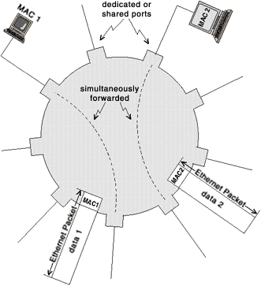
A LAN Switch
The computer has a segment to itself – the segment is busy only when a frame is being transfered to or from the computer
As a result, as many as one-half of the computers connected to a switch can send data at the same time

Slide 32
Protocol Stacks with Bridges or Switches
Telnet, FTP,
HTTP, email
application
application
transport
transport
network
network
CSMA/CD
data link
data link
10Base-T
physical
physical
Host on
network 1
Host on
network 2
Bridge or switch (forwards Ethernet frames)

Slide 33
Annimation for Better Understanding
The following link will lead you to several annimations that explain important issues in the area of networking.
Play annimation 9.1 and 9.2 to understand how repeaters and bridges work.
http://www.netbook.cs.purdue.edu/othrpags/page15.htm

